Slide 1
Components of Hadoop
Presentation by
Eng Ngosa Gathams

Slide 2
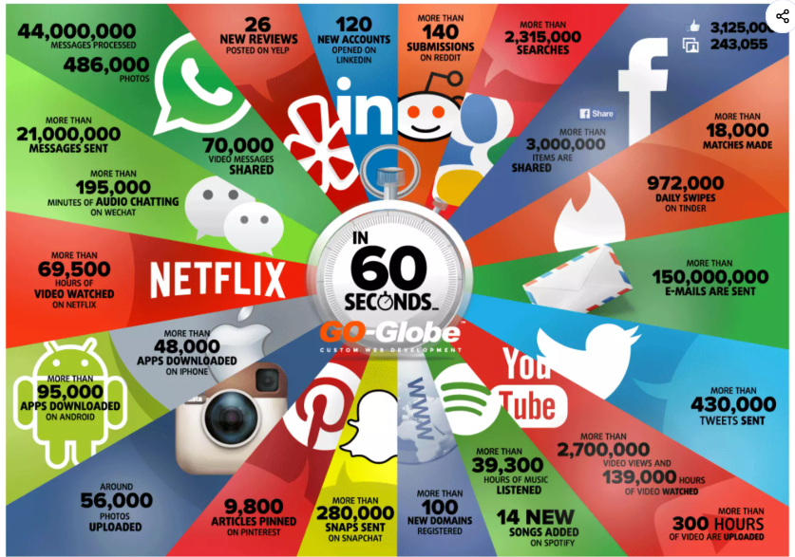

Slide 3
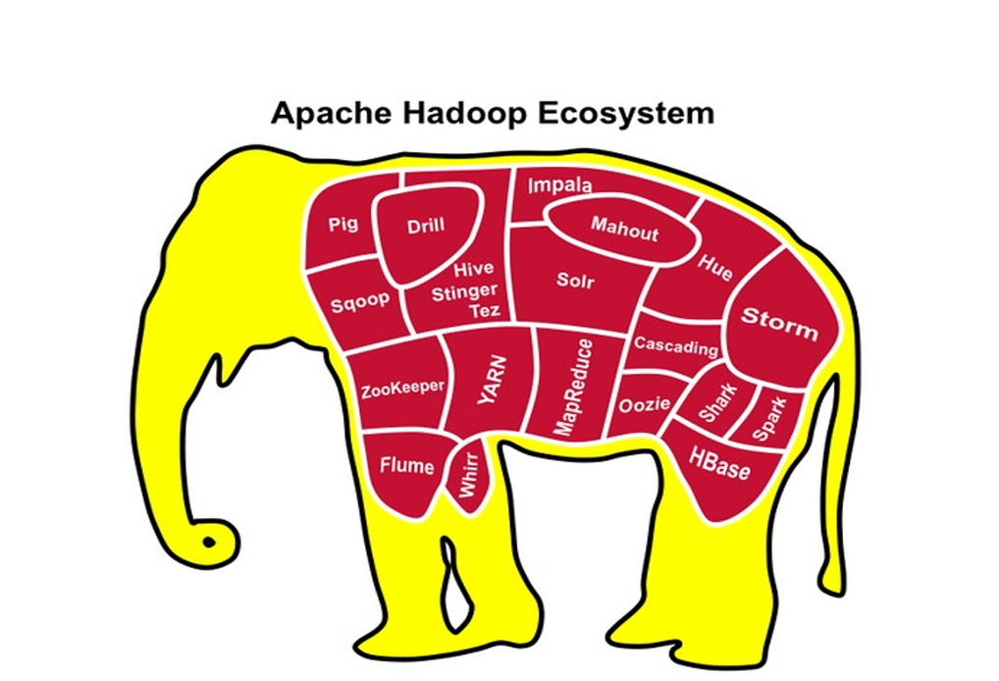

Intro to Hadoop
Presented by: Jon Bloom
Senior Consultant, Agile Bay, Inc.

Slide 4
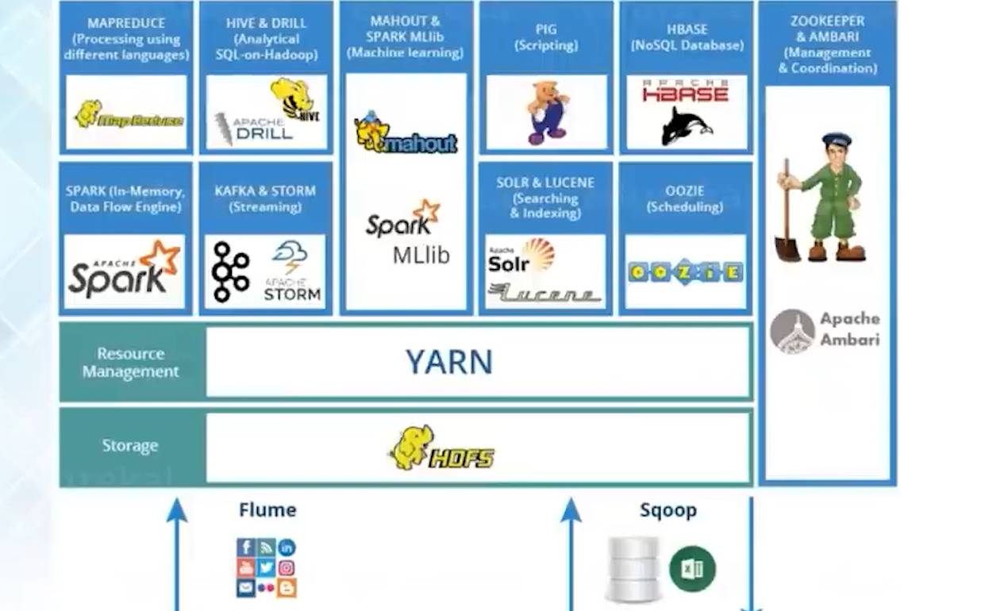

Slide 5
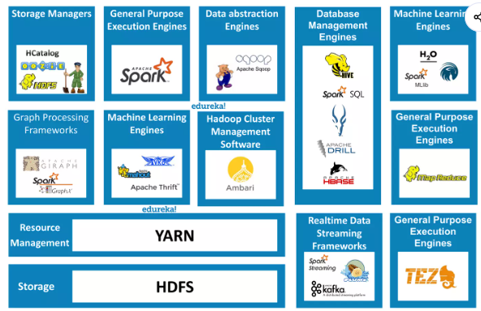

Slide 6
Hadoop storage managers

Slide 7
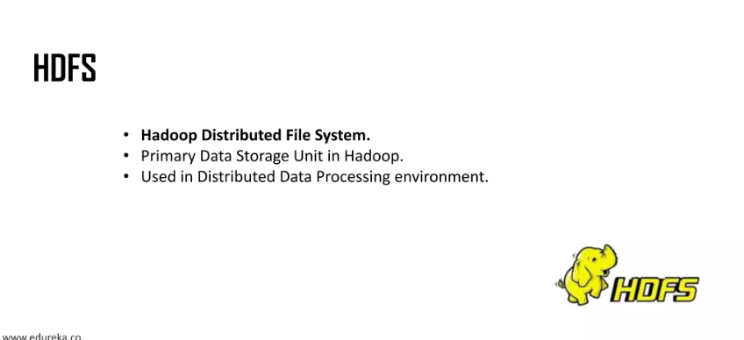

Slide 8

HCatalog
Sometimes when developing, users don't know where data is stored. And sometimes the data can be stored in a variety of formats, because HIVE, PIG and Map Reduce can have separate data model types. So HCatalog was created to alleviate some of the frustration. It's a table abstraction layer, meta data service and a shared schema for Pig, Hive and M/R. It exposes info about the data to applications.

Slide 9
Hive
Once data gets moved to Hadoop HDFS, you can add a layer of HIVE on top which structures the data into relational format. Once applied, the data can be queried by HIVE SQL. If creating a table, in the HIVE database schema, you can create an External table which is basically a metadata layer pass through which points to the actual data. So if you drop the External table, the data remains in tact.

Slide 10
OOZIE
A Java Web application used to schedule Hadoop jobs. Combines multiple jobs sequentially into one logical unit of work.

Slide 11
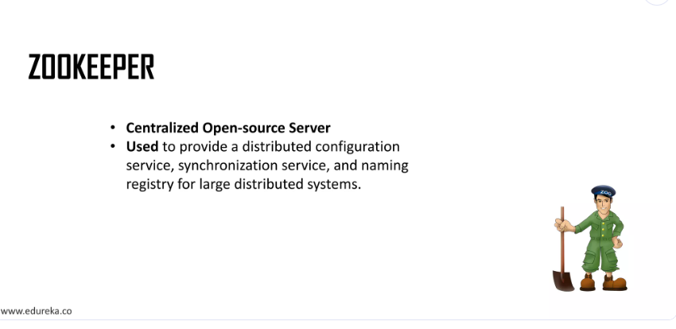

Slide 12
General purpose execution machines

Slide 13
MapReduce
HIVE and PIG allow easier access to the data
However, they still get translated to M/R

Slide 14
Tez
Generalized data flow programming framework, built on Hadoop YARN for batch and interactive use cases, such as Pig, HIVE and other frameworks. It has the potential to replace the MapReduce execution engine.

Slide 15
Spark
And Spark, provides a simple and expressive programming model that supports ETL, Machine Learning, stream processing and graph computation.

Slide 16
Database Management engines

Slide 17
Name Nodes
The “Brains” of Hadoop
“Master” Server
Single Point of Failure

Slide 18
Data Nodes
“Slaves”
Commodity Hardware
Stores the Actual Data
Runs Java Jar Files

Slide 19
Secondary Named
Nodes
Redundant Server
  Serves as Backup
Typically on own Server

Slide 20
Job Tracker
Keeps track of “Jobs” Resources
Heartbeat

Slide 21
Task Tracker
Keeps track of “Task” Resources
Communicates with Job Tracker

Slide 22
Ingest Data
When thinking about Hadoop, we think of data. How to get data into HDFS and how to get data out of HDFS. Luckily, Hadoop has some popular processes to accomplish this.

Slide 23
SQOOP
SQOOP was created to move data back and forth easily from an External Database or flat file into HDFS or HIVE. There are some standard commands for moving data by Importing and Exporting data. When data is moved to HDFS, it creates files on the HDFS folder system. Those folders can be partitioned in a variety of ways. Data can be appended to the files through SQOOP jobs. And you can add a WHERE clause to pull just certain data, for example, just bring in data from yesterday, run the SQOOP job daily to populate Hadoop.

Slide 24
PIG
In addition, you can use a Hadoop language called PIG (not making this up), to massage the data into a structure series of steps, a form of ETL.

Slide 25
ODBC
From HIVE SQL, the tables are exposed to ODBC to allow data to be accessed via Reports, Databases, ETL, etc.
So as you can see from the basic description above, if you can move data back and forth easily between Hadoop and your Relational Database (or flat files).

Slide 26
Connect to Data
Once data is stored in HDW, it can be consumed by users via HIVE ODBC or Microsoft PowerBI, Tableau, Qlikview or SAP HANA or a variety of other tools sitting on top of the data layer, including Self Service tools.

Slide 27
HBase
Hbase allows a separate database to allow random read/write access to the HDFS data, and surprisingly it too sits with the HDFS cluster. Data can be ingested to HBASE and interpreted On Read, which Relational Databases do not offer.

Slide 28
Accumulo
A High performance Data Storage and retrieval system with cell-level access control, similar to Google’s “Big Table” design.

Slide 29
Flume
Distributed, reliable and available service for efficiently collection, aggregating and moving large amounts of streaming data into HDFS (fault tolerant).

Slide 30
Solr
Open Source platform for searches of data stored in HDFS Hadoop including full text search and near real time indexing.

Slide 31
Streaming
And you can receive Steaming Data.

Slide 32
HUE
Open Source Web Interface
Aggregates most common components into single web interface
View HDFS File Structure
Simplify user experience

Slide 33
WebHDFS
A REST API
  Interface to expose complete File System
    Provides Read & Write access
    Supports all HDFS parameters
    Allows remote access via many languages
    Uses Kerbos for Authentication

Slide 34
Monitor
There's Zookeeper which is a centralized service to keep track of things. A high performance coordination service for distributed applications.

Slide 35
Machine Learning
In addition, you could apply MAHOUT Machine Learning algorithms to you Hadoop cluster for Clustering, Classification and Collaborative Filtering. And you can run Statistical language analysis with a language called Revolution Analytic R version of Hadoop R.

Slide 36
Machine Learning
Clustering
  Similarities between data points in Clusters
Classification
  Learns from existing categories to assign unassigned categories
User Based Recommendations
  Predict future behavior based on user preferences and behavior

Slide 37
Hadoop 2.0
And with the latest Hadoop 2.0, there's the addition of YARN which is a new layer that sits between HDFS2 and the application layers. Although HDFS Map Reduce was originally designed as the sole batch oriented approach to getting data from HDFS, it's no longer the sole way. HIVE SQL has been sped up through Impala which completely bypasses Map Reduce and the Stinger initiative which sits atop Tez. Tez has ability to compress data with column stores which allows the interaction to be sped up.

Slide 38
YARN
Allows the separation of MapReduce layers of Service and Framework
Resource Manager
Application Manager
Node Manager
Containers
Separates Resources

Slide 39
YARN
Traditional MapReduce
  Expensive
    Original M/R spawned many process
    Wrote to Disk intermediate data
    Sort / Shuffle
Now we have Applications
M/R, Tez, Giraff, Spark, Storm, etc.
Compiled down to a lower level
  Single Strand w/ More Complexity

Slide 40
Impala
Cloudera Impala is runs massively parallel processing (MPP) SQL query engine that runs natively in Hadoop.
Allows data querying without the need for data movement or transformation
It by-passes MapReduce

Slide 41
Graph
And Girage, which allows Hadoop the ability to process Graph connections between nodes.

Slide 42
Ambari
Ambari allows Hadoop Cluster administration and has an API layer for 3rd party tools to hook into.

Slide 43
Knox
Provides a single point of authentication and access to Hadoop services. Specifically for Hadoop users who access the cluster data and execute jobs, operators who control access and manage the cluster.

Slide 44
Falcon
Framework for simplifying data management and pipeline processing in Hadoop. Enables users to automate the movement and processing of datasets for ingest, pipelines, disaster recovery and data retention use cases. It simplifies data management by removing complex coding (out of the box).

Slide 45
More Apache
Projects
Apache Kafka
  Next Generation Distributed Messaging System
Apache Avro
  Data Serialization System
Apache Chukwa
  Data Collection System for Monitoring large distributed systems

Slide 46
Cloud
You can run your Hybrid Data Warehouse in the Cloud with Microsoft Azure Blobstorage HDInsight or Amazon Web Services.

Slide 47
On Premise
You can run On Premise with IBM Infosphere BigInsights, Cloudera, Hortonworks and MapR.

Slide 48
Hybrid Data
Warehouse
You can build a Hybrid Data Warehouse. As Data Warehousing is a concept, a documented framework to follow with guidelines and rules. And storing the data in Hadoop and Relational Databases is typically known as a Hybrid Data Warehouse.

Slide 49
BI vs. Hadoop
Hadoop not a replacement of BI
Extends BI capabilities
BI = Scale up to 100s of Gigabytes
Hadoop = From 100s of Gygabytes to Terabytes
(1,000s og Gygabytes) and Terabytes (1,000,000 Gigabytes)

Slide 50
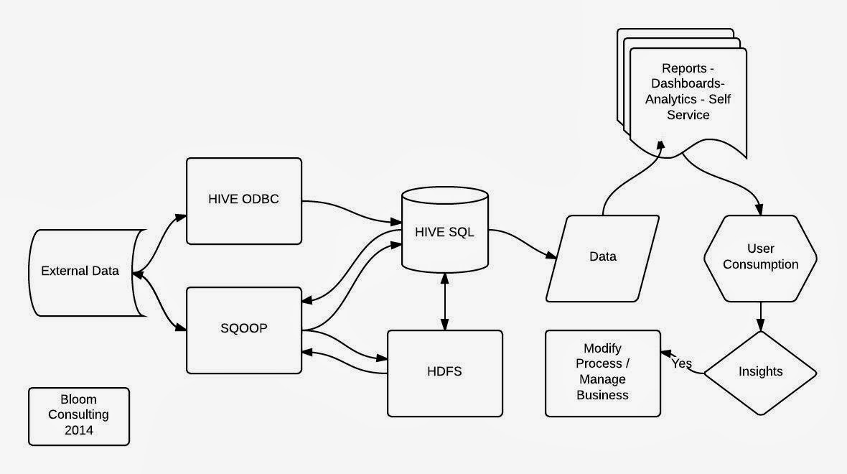
Hadoop

Slide 51
Where’s Hadoop
Headed?
Transactional Data?
More Real Time?
Integrate with Traditional Data Warehouses?
Hadoop for the Masses?
Artificial Intelligence?
  Turing Test
  Neural Networks
Internet of Things

Slide 52
Demo
Basic Hadoop

Slide 53
Thank you for attending!
Q & A
Blog: | www.bloomconsultingbi.com
Twitter: | @gathams
Linked-in: | http://www.linkedin.com/in/BloomConsultingBI
Email: | gathams@icloud.com

